Slide 1

Sales & Profit Performance Dashboard
Sales & Profit Performance Dashboard
By K.Sion Rani

Slide 2
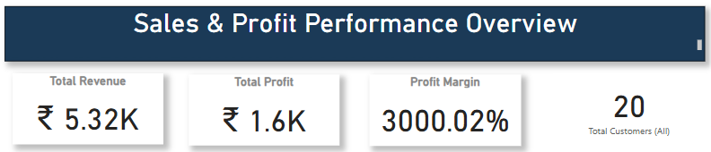
To design an interactive Power BI dashboard for stakeholders to analyze sales, profit, and customer performance over time and regions.

Slide 3

Tools & Technologies
Power BI Desktop
DAX Measures
Power Query
Bar & Column Charts, Card Visuals, and Slicers

Slide 4
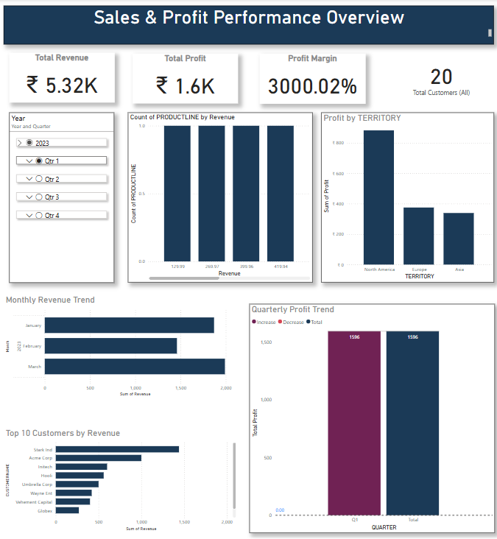
Dashboard Layout Explanation
The layout is divided into KPI Cards, Time & Region Filters, Revenue/Profit Visuals, and Trend Analysis.
Sections:
Top: KPIs
Left: Filters (Quarter)
Middle: Revenue by Product Line, Profit by Territory
Bottom: Monthly Trend, Quarterly Trend, Top Customers

Slide 5
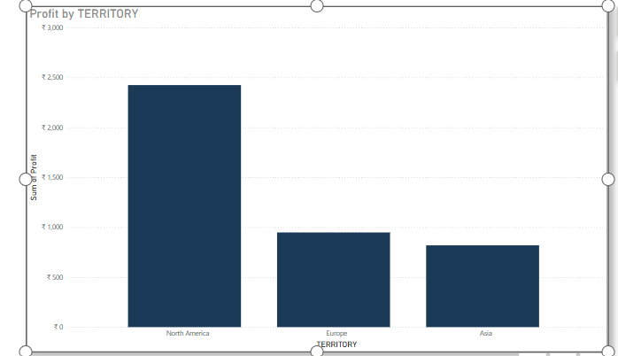
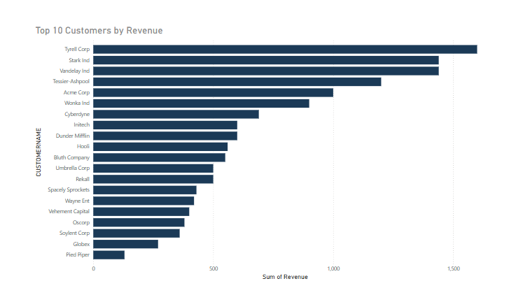
Insights & KPIs
💰 Total Revenue: ₹2.89K
📈 Total Profit: ₹866.97
🧮 Profit Margin: 3000.04%
👥 Customers: 20
Top Territory: North America
Best Month: August
Top Customer: Tyrrell Corp

Slide 6
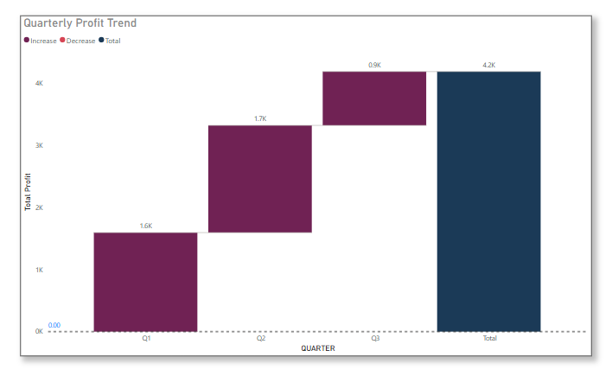
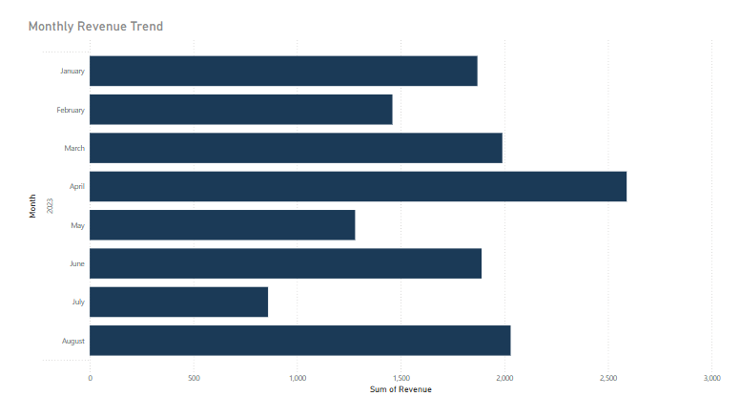
Trends & Time Analysis
Time-series analysis reveals growth patterns across months and quarters. Q3 shows the highest profit of ₹867.
Q3 shows the highest profit of ₹867.

Slide 7
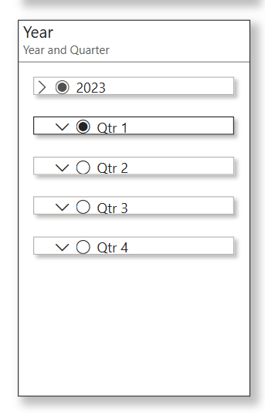
Interactivity & Filters
Users can filter data using the slicer for Quarters (Q1–Q3) to dynamically update all visuals in real-time.
Quarter Slicer: Allows users to filter the entire dashboard by Q1, Q2, or Q3.
🔄 Dynamic Visuals: All charts update instantly based on slicer selection for real-time exploration

Slide 8
Conclusion
The dashboard effectively communicates key business metrics. It supports smarter decisions by offering a detailed, filterable view of performance over time, regions, and customers

